Slide 1
Superpixel preprocessing as data reduction in image recognition
Mitan Theodor-Alexandru
Coordonator: Lect. Dr. Benchea Razvan

Slide 2
Outline
We use clustering to reduce computational effort and training time required for image recognition with a simpler neural network architecture that trains very rapidly.
As such, we use a combination of two fundamental machine learning techniques.

Slide 3
Problems addressed
CNNs require GPU use or high-powered machines
Long training times vs. rapid innovation / testing
Complex architectures
Per-image testing time can be too high
Fixed input size

Slide 4


The Process
Acquire images CIFAR-10 and ImageSoup scraping.
K-means on pixels Cluster / segment the pixel
Centroids to neural network Use the 5-D centroids as input for a neural network that solves the classification problem

Slide 5
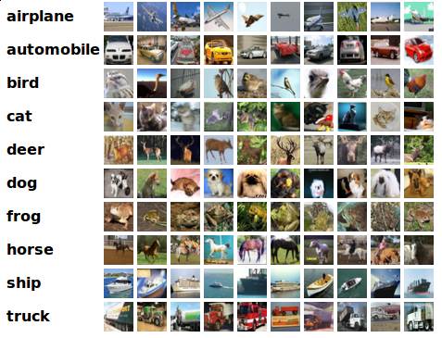
CIFAR-10: 60.000 small images

Slide 6

Scraping: suns and moons

Slide 7
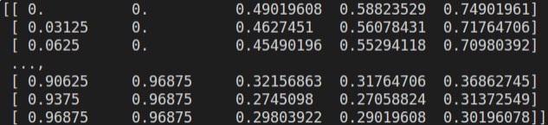
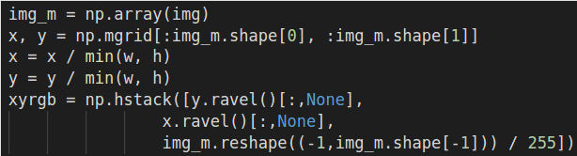
Images to XYRGB
Flattened meshgrid
Each 5-D unit has its coordinates normalised by the shortest side
Normalised RGB
We normalise the RGB components to [0, 1].

Slide 8
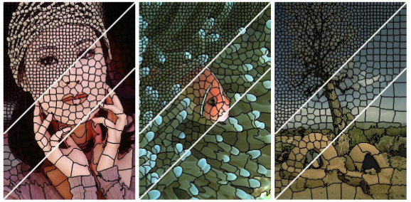
Superpixels (SLIC)
Inspiration: SLIC
SLIC superpixels use a combination of spatial and chromatic distance in the La*b* space

Slide 9
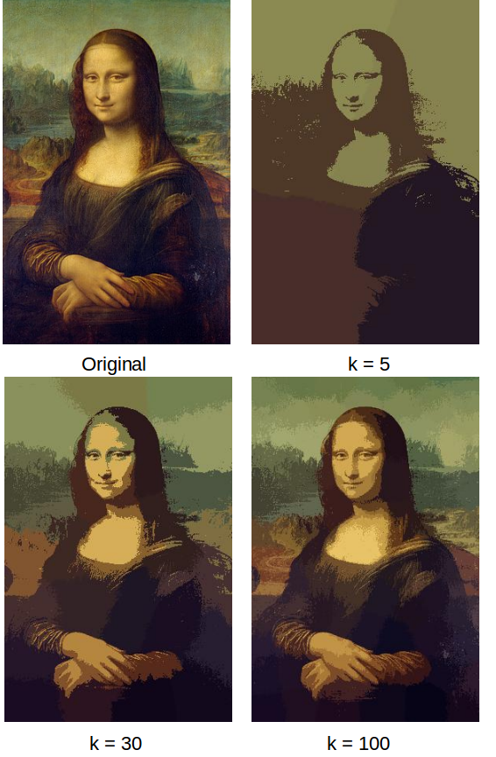
Superpixels:
k-means
XYRGB clustering
My model: X, Y, R, G, B are considered similarly, but the first two are “tweaked”.

Slide 10
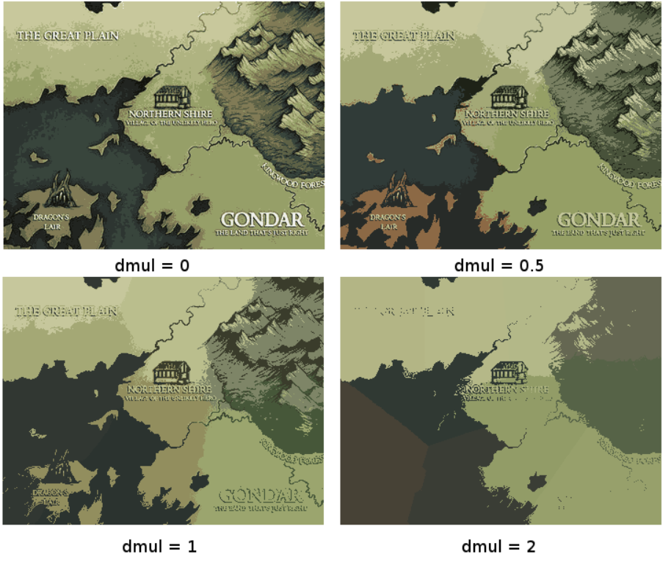
Low dmul
Colour reduction
(space doesn’t matter)
High dmul
Detail lost, space matters more than colour.

Slide 11
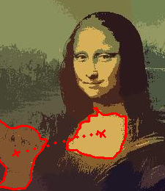

Superpixels to input
“Cellbatch” uses the averages of each superpixel
“Relbatch” uses batches of relationships with Euclidean metrics

Slide 12
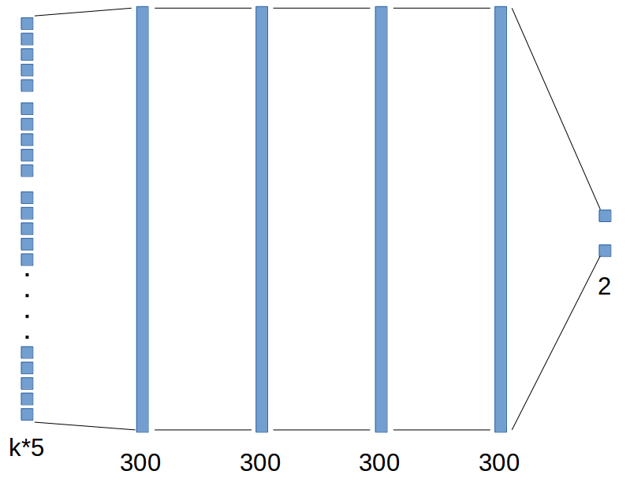
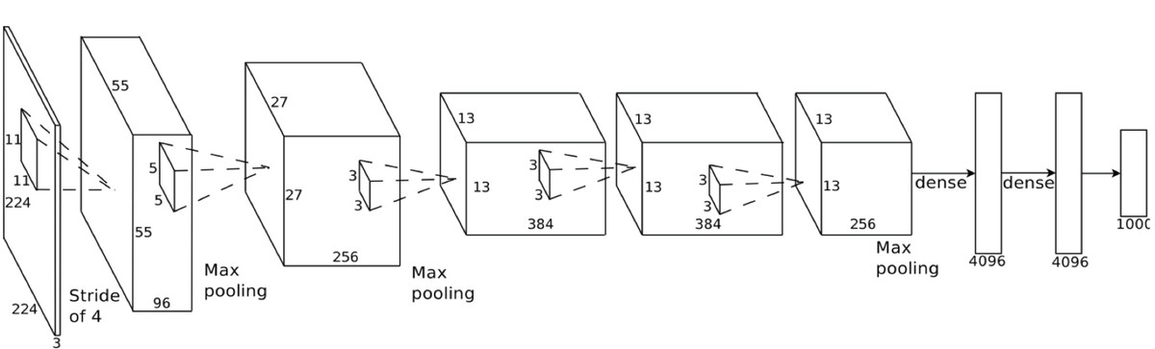
The neural network
CNN
Cellbatch

Slide 13
Rules
30 clusters
20 epochs
All images
We track accuracy and time
Baseline: flat, fully-connected network
Other parameters
Each algorithm has its own parameters, and they have been tweaked to roughly similar degrees of complexity

Slide 14
Accuracy for “CIFAR-2”
Cellbatch: ~85%
Relbatch: ~86%
Flat: ~50%
Data size
Cellbatch has reduced the input data to under a tenth of its original size.
Relbatch has increased it slightly, depending on number of relationships.

Slide 15
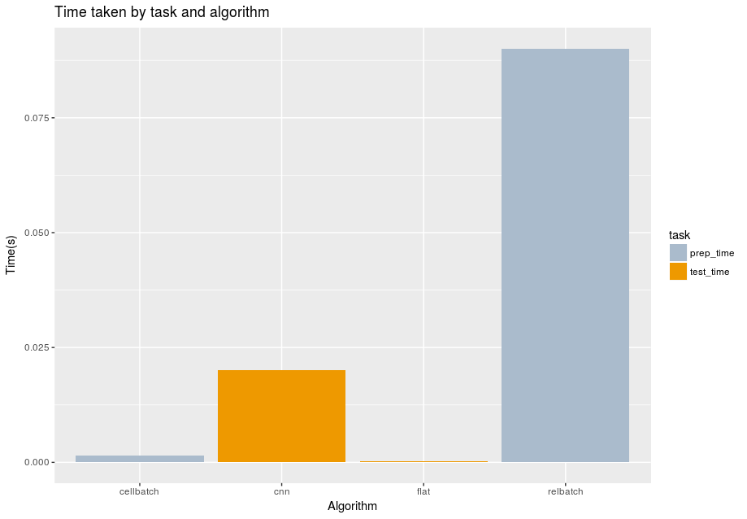
Timing

Slide 16
Gif, demos (changing dmul)

Slide 17
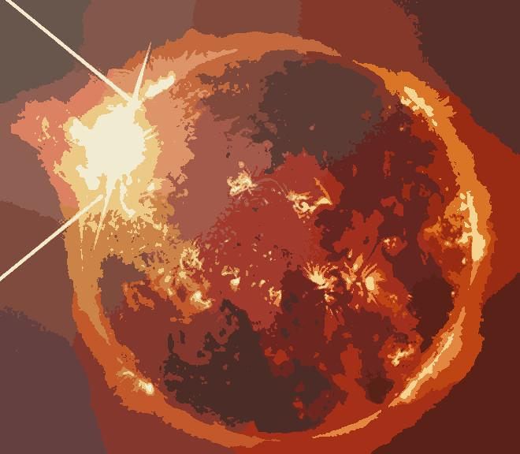

Correctly classified suns

Slide 18

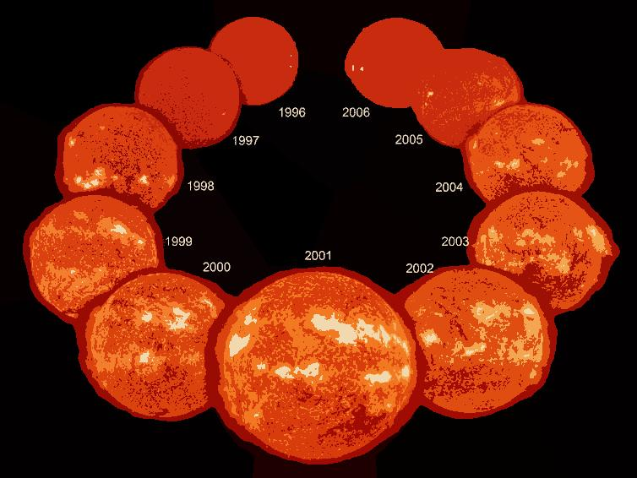
Correctly classified suns

Slide 19
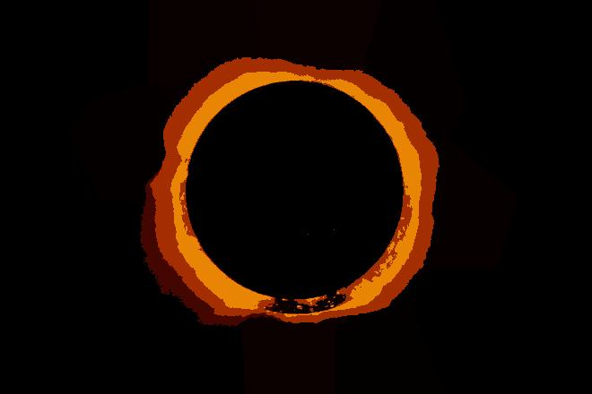

Wrongly classified suns

Slide 20
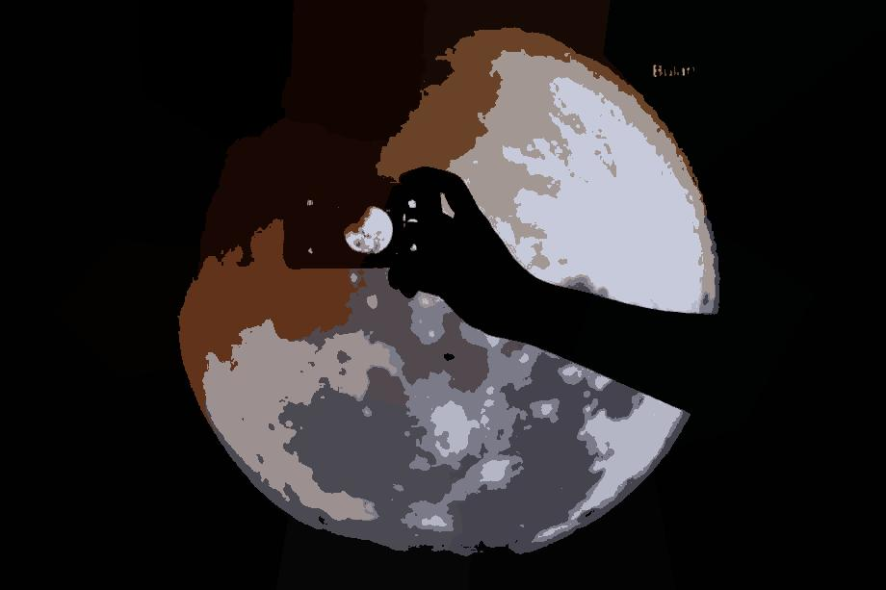
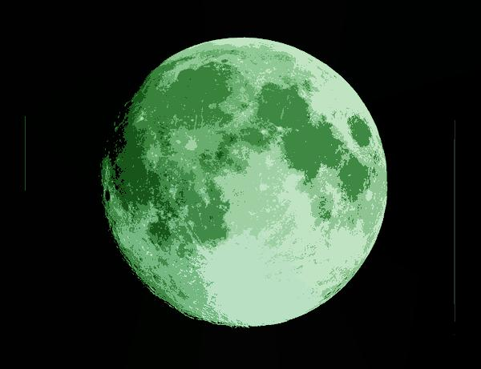
Correctly classified moons

Slide 21
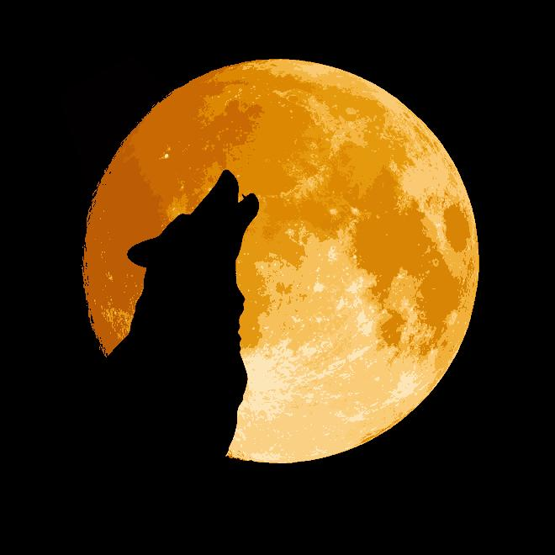
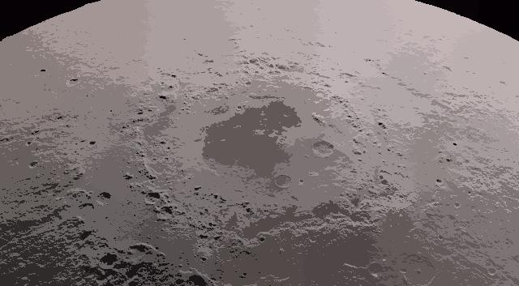
Correctly classified moons

Slide 22


Wrongly classified moons

Slide 23
Further work
Better use of the superpixels’ immediate neighbourhood
Cluster analysis on superpixels
SLIC-like optimisations (limited search space)

Slide 24
Conclusions
Reasonable accuracy with very fast training times
Simple architecture
Flexible input size and type
Substantial data reduction
Effort moved to preprocessing, testing is almost instant: can prepare data regardless of network architecture

Slide 25
Questions

